Slide 1

Delegation of Procurement Authority by Chante Johnson
Understanding the Laws and Best Practices

Slide 2

What does delegation of procurement authority mean?
Delegation of procurement authority in the State of Texas refers to the assignment of specific procurement responsibilities from the Statewide Procurement Division (SPD) to individual agencies. This allows agencies to conduct certain types of procurements, such as one-time purchases of goods up to $50,000, without needing direct oversight from SPD. The delegation ensures that procurement activities are efficient and comply with state laws and best practices.

Slide 3

The Crucial Role of Delegation in the Procurement Process
Efficiency: It streamlines the procurement process by reducing bureaucratic delays, enabling agencies to make timely purchasing decisions and respond quickly to needs.
Empowerment: It empowers individual agencies to manage their own procurement activities within established guidelines, fostering accountability and ownership of the procurement process.
Compliance: It ensures that procurement activities adhere to state laws and best practices, maintaining transparency, fairness, and integrity in the acquisition of goods and services.

Slide 4
Relevant Laws and Regulations in Texas
Texas Government Code, Chapter 2155
Outlines the rules and procedures for state purchasing.
Includes guidelines for large expenditures, conflict of interest, and competitive bidding requirements.
Texas Local Government Code, Chapters 252 and 271
Framework for municipal procurement.
Covers processes for purchasing goods, services, and construction.
Texas Government Code, Chapters 2253, 2254, 2269, and 2271
Addresses procurement of professional services, construction, and other specific procurement activities.

Slide 5

Delegated Procurements
One-time purchases of goods not exceeding $50,000
Purchases of services not exceeding $100,000
Direct publications
Professional memberships
Purchases of perishable goods
Distributor purchases
Fuel, oil, and grease purchases
Internal repair purchases
Emergency purchases

Slide 6

Procedures for Proprietary Purchases
Proprietary purchases involve acquiring unique products or services from a single vendor due to exclusive rights (e.g., patents, copyrights).
Agencies must provide a written justification to the SPD explaining:
The necessity of the specific product.
Why no equivalent product is available.
The agency head or presiding officer must sign the written justification.
Once approved by the SPD, the agency can proceed with the purchase without competitive bidding.

Slide 7

Requesting Assistance from SPD
For Procurements Under Delegated Threshold
Delegation Request: Agencies can submit a procurement-specific delegation request to SPD.
Use an Open Market Requisition (OMR) for goods.
Use the Procurement Oversight & Delegation portal for services.
Justification: Include a detailed justification and any necessary documentation to support the procurement request.
Submission:
Email the OMR for goods.
Submit through the Procurement Oversight & Delegation portal for services.
Approval: Await SPD's review and approval to proceed with the procurement

Slide 8
Spot Purchases
Spot purchases are small, one-time procurements.
Total contract value does not exceed $10,000 (with the exception of printing services).
Competitive bidding is not required for these purchases.
Agencies may supplement the Centralized Master Bidders List (CMBL) with non-CMBL vendors.
Dividing purchases to avoid competitive bidding is explicitly prohibited.

Slide 9
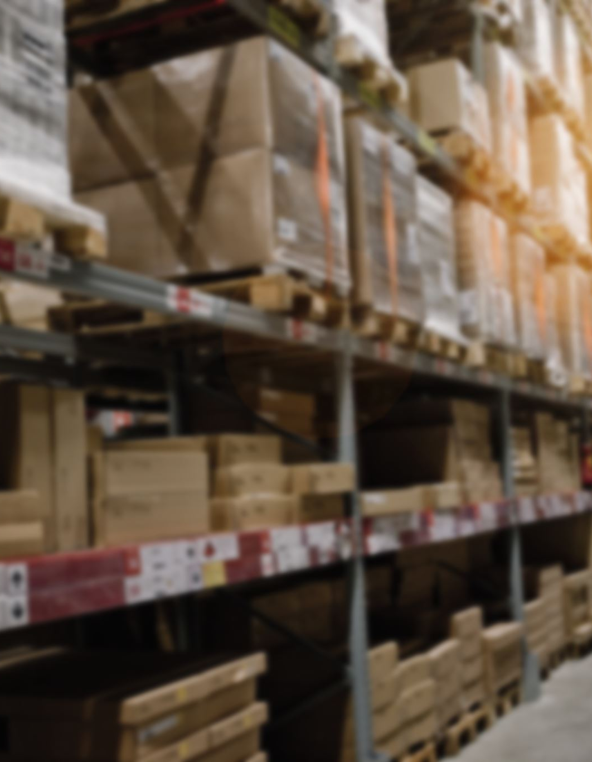
Delegation of One-Time Purchases of Goods
Under $50,000
Delegation by SPD: The Statewide Procurement Division (SPD) delegates the purchasing functions of one-time purchases of goods to individual agencies.
Threshold: The delegation applies to purchases, including goods for resale, that do not exceed $50,000.
Goods Definition: Goods refer to supplies, materials, and equipment needed by the agency.
Cost Estimation: Agencies must develop the cost estimate in good faith to determine the contract value.

Slide 10

Case Study Scenario
Scenario:
The Texas Department of Health (TDH) needs to purchase new laboratory equipment for an upcoming research project. The estimated cost for the equipment is $45,000. Additionally, TDH requires specialized consulting services for the project, with an estimated cost of $90,000.
Questions:
Laboratory Equipment Purchase:
Can TDH proceed with the purchase of laboratory equipment without seeking approval from the Statewide Procurement Division (SPD)?
What delegation rules apply in this scenario?
Notes:
SPD has delegated the purchasing functions of one-time purchases of goods to individual agencies for amounts not exceeding $50,000.Since the estimated cost of the laboratory equipment is $45,000, which is within the $50,000 threshold, TDH can proceed with the purchase under the delegated authority. TDH must ensure that the cost estimate is developed in good faith and adheres to all relevant procurement guidelines and procedures.

Slide 11
Quiz
Question 1: What is the maximum value for one-time purchases of goods that can be delegated to agencies?
a) $10,000
b) $50,000
c) $100,000
Question 2: What type of purchases do not require competitive bidding if the total value is $10,000 or less?
a) Printing services
b) Spot purchases
c) Emergency purchases
Notes:
Question 1: What is the maximum value for one-time purchases of goods that can be delegated to agencies? Answer: b) $50,000Question 2: What type of purchases do not require competitive bidding if the total value is $10,000 or less? Answer: b) Spot purchases

Slide 12

Conclusion
Delegation allows agencies to make timely purchasing decisions, streamlining the process and ensuring compliance with state laws and best practices.
SPD delegates purchasing authority to agencies for specific types of procurements, such as one-time purchases of goods up to $50,000 and services up to $100,000.
Agencies must provide a written justification for proprietary purchases, explaining the necessity and uniqueness of the product, and obtain SPD approval.
Spot purchases are small, one-time procurements with a total value of $10,000 or less (excluding printing services) that do not require competitive bidding.
SPD delegates one-time purchases of goods, including goods for resale, to agencies for amounts not exceeding $50,000. Agencies must develop cost estimates in good faith.
Agencies can request procurement assistance from SPD for procurements under the delegated threshold by submitting a detailed justification and necessary documentation through appropriate channels

Slide 13

Questions?

